Slide 1
Software Design Process
CSE-474 Software System Design & Architecture

Slide 2
Outline
Software Design
Viewpoints/Representations
Design process
Levels of design
Software design principles
Software design methods

Slide 3
Software Design
A software design is a meaningful engineering representation of some software product that is to be built.
  “The process of applying various techniques and principles for the purpose of defining a device, a process or a system in sufficient detail to permit its physical realization” [TAY59]
A design can be traced to the customer's requirements and can be assessed for quality against predefined criteria.
It lays down the groundwork for achieving non-functional requirements (performance, maintainability, reusability, etc.)
It takes target technology into account (e.g., kind of middleware, database design, etc.)

Slide 4
Software Design …
From abstractions to systems
  abstractions allow us to ignore implementation details of procedures and data structures
  for large systems, we need to abstract away even more detail
  we need to represent higher level abstractions

Slide 5
Viewpoints/Representations
Viewpoints help in creating abstractions
A viewpoint tells you which details you can ignore when forming an abstraction
It defines which details are relevant and which are not
Viewpoints can overlap
  Some aspects of a design are common to several viewpoints

Slide 6
Design Representations
Design representations will:
  help us to see the big picture
  allow us to communicate our designs with others
    customers, managers, other developers,
    people with varying technical expertise
  allow us to measure various quality attributes
    completeness, consistency, complexity

Slide 7
Software Design Representations
Structural
  Static properties
Functional
  Tasks performed by system
Behavioural
  Cause and effect, system behaviour
Data Modeling
  Data objects and their relationships

Slide 8
Software Design in SDLC
In SDLC (Software Development Life Cycle), Design phase is one of the most important phases.
In the software engineering context, design focuses on four major areas of concern: data, architecture, interfaces and procedures/components.

Slide 9
Design Process
During the design process, the software specifications are transformed into design models that describe the details of the data structures, system architecture, interface, and components.
The emphasis in design phase/process is on quality.
This phase provides us with representation of software that can be assessed for quality.

Slide 10
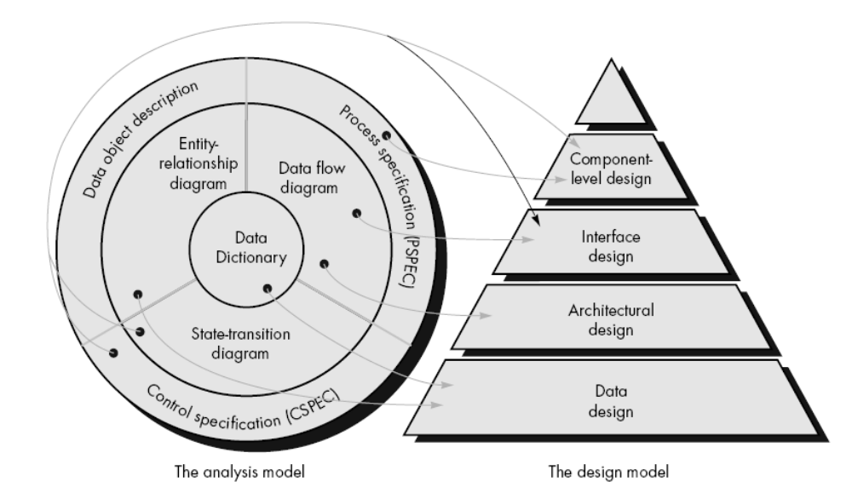
Analysis to Software design

Slide 11
Design Process Activities
Architectural design
Abstract specification
Interface design
Component design
Data structure design
Algorithm design

Slide 12
Levels of Software Design
Architectural design (high-level design)
  architecture - the overall structure, main modules and their connections
  addresses the main non-functional requirements (e.g., reliability, performance)
  hard to change
Detailed design (low-level design)
  the inner structure of the main modules
  detailed enough to be implemented in the programming language

Slide 13
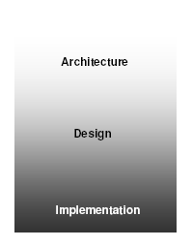

Slide 14
Software Design should be:
Simple
Correct & Complete
Loosely coupled
Understandable
Adaptable(Flexible)

Slide 15
Software Design Principles
Always consider alternative approaches
The design should be traceable to the analysis model
The design should not reinvent the wheel
The design should minimise intellectual distance between the software and the problem as it exists in the real world.
The design should exhibit uniformity and integration
  A design is uniform if it appears that one person developed the whole thing.
  A design is integrated if care is taken in defining interfaces between design components.

Slide 16
Software Design Principles contd…
The design should be structured to accommodate unusual circumstances (consider exceptions/errors)
The design should be reviewed to minimize conceptual (semantic) errors
Design is not coding, coding is not design
  Even when detailed designs are created for program components, the level of abstraction of the design model is higher than source code.
The design should be structured to accommodate change
The design should be assessed for quality as it is being created

Slide 17
Software Design Methods
Structured Methods
  Process functions are identified
Object-Oriented
  develop an object model of a system
Data-Oriented
  Entities are determined for each sub-system, then entity inter-relationships are examined to develop the additional entities needed to support the relationships.
Component-based
  Divide the system into components
Formal Methods
  Requirements and programs are translated into mathematical notation

Slide 18
Which method to choose?
Data oriented design is useful for systems that process lots of data, e.g. database and banking applications
Structured design is useful for process intensive(demanding) systems that will be programmed using a procedural language such as FORTRAN.
OO methods are useful for any system that will be programmed using an object oriented language such as C++.
Component-based Methods are used for the large systems that can be modularized.
Formal methods are considered to be an alternative to OO and classical design methods, but their use is expensive and claims of reduced errors remain unproven. However, the ability to formally validate the correctness of a software artifact is appealing and research on formal methods is ongoing.

Slide 19
Software Design Strategies
Divide-and-conquer/stepwise refinement
Top-down vs. bottom-up
Data abstraction and information hiding
Use of heuristics(find or discover)
Use of patterns and pattern languages
Iterative and incremental approach

Slide 20
Design Documentation
“Design without documentation is not a design”
The design is usually documented as a set of graphical models.
Possible models
  Process Models
  Data-flow model
  Entity-relation model
  Structural model
  Object models

Slide 21
Reading for Next Week
Read initial chapters on Software Design from Pressman’s “Software Engineering”.
(Chapter 13-14 of 4th edition book)
Rest of the reading material for Week 2 will be available from
  http://learn.mcs.edu.pk
  Look for Adv Software Design course in Fall 2010 category of MS Software Engineering category.
  Login as guest.

